Slide 1
CIVICS
ACTIVITY TO BE DONE ON
UNIT 3 AND 4

Slide 2

GROWING UP AS BOYS AND GIRLS
GENDER AND RELATED ISSUES

Slide 3
WHO TOLD YOU THAT YOU WERE A BOY OR A GIRL?

Slide 4
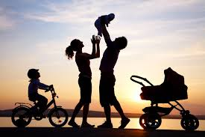

LET’S LOOK AT THEM ONE BY ONE

Slide 5
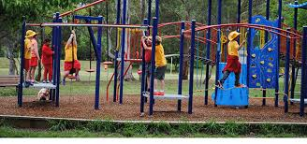
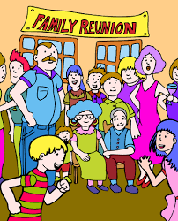
ALL OUR SOCIAL GROUPS

Slide 6
LET’S MAKE A LIST OF GENDER DIFFERENCES I NOTICE IN MY HOUSE

Slide 7
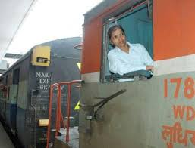
NOW LET’S READ ABOUT THOSE WHO FOUGHT AGAINST THIS DISCRIMINATIOM

Slide 8


Slide 9


Slide 10
WOMEN’S MOVEMENT
WHAT FOR?
FOR VOTING RIGHTS
AGAINST SEXUAL HARASSMENT
DOWRY DEATHS
VIOLATIONS
DISCRIMINATION

Slide 11
WORK TO BE DONE
FIND OUT(PUT A PICTURE)
WHEN AND WHERE DID THE FIGHT FOR VOTING RIGHTS TAKE PLACE?
HOW HAS PROPERTY- LAW BEEN CHANGED TO FAVOR WOMEN?

